Slide 1

CSCE 585 Project Proposal Intelligent In-Network Attack Detection
Sergio Elizalde, Amith GSPN, Samia Choueiri
Department of Integrated Information Technology
University of South Carolina
August 28, 2025

Slide 2
Outline
Problem Statement
Proposed Solution
Evaluation Metrics

Slide 3
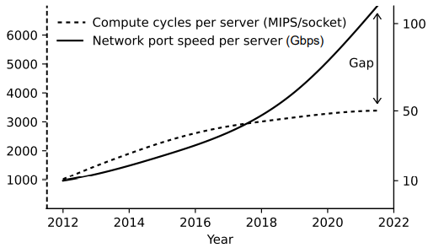
Problem Statement
Cyberattacks are evolving, and more intelligent approaches are needed
Network speed is increasing, raising the need for in-network acceleration
Traditional defenses alone are no longer sufficient, requiring adaptive and AI-driven security solutions.
As data volumes grow, systems must process and respond in real time to keep pace with modern demands.
Figure: G. Elinoff, “Data centers are overloaded. The inventor of FPGAs is swooping in with a “comprehensive” SmartNIC,” March 2020.

Slide 4
Proposed Solution
Based on trained data
ML Model
Network traffic data
Feature Extraction
Detection
Decision
Block / Alert
Knowledge Base
Attack signatures

Slide 5
Evaluation Metrics
Accuracy
Inference Time
Achieve faster model execution without sacrificing quality.
Latency
Ensure rapid system responsiveness with minimal overall system delay.
Deliver the most precise and reliable results possible with minimal misses and false alerts.
Notes:
Sergio

Slide 6
THANK YOU!

